Slide 1
Subtopic N3.24 – Introduction to Primes
LEARNING OUTCOME: To be able to describe the properties of prime numbers and write numbers as a product of prime factors.
Objectives:
Keywords:
Prime
Factor
Product
To be able to recognise prime numbers.
To be able to use prime numbers in problem solving.
To be able to write a number as a product of its prime factors
Introduction:
Prime numbers are special numbers greater than 1 that can only be divided evenly by 1 and
themselves. For example, 2, 3, 5, and 7 are prime numbers because they have no other factors. Every
whole number can be broken down into a product of prime numbers, called its prime factorisation.
This is like finding the building blocks of a number—it's a way to express any number using only primes.
Definition
Characteristics
A positive integer with precisely two distinct factors.
The factors of the number will be 1 and the number itself.
Examples
Prime Number
Non - Examples
2 3 5
1 4 6
7 11 13 17
9 15 25 27
19 23 29
36 39 50
31 37 41 43
72 63 81 -2
Definition
Characteristics
A positive integer with three or more factors.
4 is the smallest composite number
2 is the only even number that is not composite.
Examples
Composite Number
Non - Examples
4 6 8
0 1 2
9 10 12 14
3 5 7 11
15 16 18
13 17 19
Identifying prime and composite numbers
Example 1 - I do…
Example 2 – We do…
Example 3 – You do…
Steps | List the factors of 24 | List the factors of 25 | List the factors 18
1) Starting with 1, list the pairs of factors that multiply to make the number.
1, 2, 3, 4, 6, 8, 24
1, 5, 25
1, 2 , 3, 6, 9, 18

Slide 2
Example 4 - I do…
Example 5 – We do…
Example 6 – You do…
Steps | List the factors of 13 | List the factors of 23 | List the factors 17
1) Starting with 1, list the pairs of factors that multiply to make the number.
1, 13
1, 23
1, 17
A prime number has exactly _________________________________________________________.
A composite number must have at least ___________________________________________________.
24, 25 and 18 are composite numbers because they have ______________________________________.
13, 23 and 17 are prime numbers because they have _________________________________________.
1 is not a composite number or a prime number because _____________________________________.
It is not possible for a positive whole number to have ________ factors.
two factors
three factors
three or more factors
two factors
it only has one factor
0
Independent Practice
1. The following numbers are prime numbers. True or false?
a) 10 | True/ False | b) 9 | True/ False
c) 8 | True/ False | d) 7 | True/ False
e) 6 | True/ False | f) 5 | True/ False
g) 4 | True/ False | h) 3 | True/ False
i) 2 | True/ False | j) 1 | True/ False
k) 15 | True/ False | l) 17 | True/ False
m) 19 | True/ False | n) 21 | True/ False
o) 23 | True/ False | p) 27 | True/ False

Slide 3
Question 1 continued.
q) 29 | True/ False | r) 32 | True/ False
s) 27 | True/ False | t) 28 | True/ False
u) 31 | True/ False | v) 37 | True/ False
w) 39 | True/ False | x) 41 | True/ False
y) 43 | True/ False | z) 47 | True/ False
aa) 51 | True/ False | ab) 53 | True/ False
ac) 59 | True/ False | ad) 59 | True/ False
ae) 69 | True/ False | af) 77 | True/ False
ag) 79 | True/ False | ah) 91 | True/ False
2. Answer the following questions:
a) Which two consecutive integers are prime numbers?
b) There is a prime number with two digits. The digits add up to 4. What is the prime number?
2 and 3
13

Slide 4
c) There is a prime number with 2 digits. The digits add up to 5. What is the prime number?
d) Circle the correct answer. When two prime numbers are added:
i) The answer is also a prime number ii) The answer is an even number iii) The answer is a composite number iv) it varies
e) Which of these numbers is both a factor of 30 and a prime number (known as a prime factor)?
1 ii) 5 iii) 6 iv) 10 v) 30
f) Find two prime numbers that have a sum of 100
23
47 and 53, 41 and 59, 29 and 71, 17 and 83, 11 and 89
3 and 97
g) Find three different prime numbers that have a sum of 40.
h) Find three different prime numbers that have a product of 165.
i) Write down three different factors of 18 that add together to give a prime number.
j) Nidah writes down two different prime numbers. She adds together her two numbers. Her answer is a square number less than 30. Find two prime numbers that Nidah could have written down.
2, 7 and 31
3, 5 and 11
2, 3 and 6 1, 3 and 9
2, 6 and 9 2, 3 and 18
2 and 7 5 and 11 3 and 13 2 and 23

Slide 5
3. Answer the following questions:
2 8 4 32 6 16 From the numbers above, write down A square The square root of 16 The cube of 2 The prime number | 3 2 13 11 9 7 From the numbers above, write a number that is: A factor of 35 Not prime An even prime A multiple of 3
15 16 17 18 20 22 24 From the numbers above, write down A prime A factor of 30 An even multiple of 3 The square root of 225 | 7 17 1 81 2 99 55 100 101 27 19 From the numbers above, write a number that is: The smallest prime The cube root of 8 A prime greater than 10 Three numbers that are composite
4 or 16
7
4
9
8
2
2
3 or 9
17
2
15
2
18 or 24
17, 19 or 101
Any three from 9, 81, 99, 55, 100 and 27
15

Slide 6
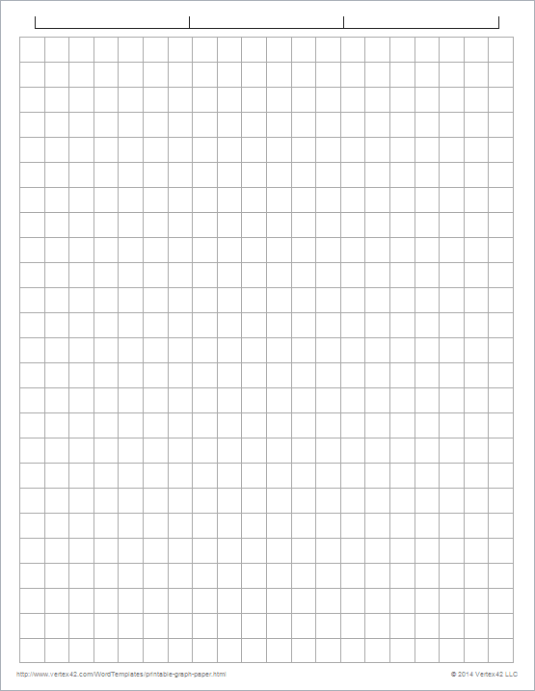
Skills Check
Which of these is a prime number?
1 B. 2 C. 4 D. 9
Tom says there are an even number of prime numbers less than 20.
Katie says there are an odd number of prime numbers less than 20.
Who do you agree with?
A. Only Tom B. Only Katie C. Neither is correct D. Both are correct
‹#›

Slide 7
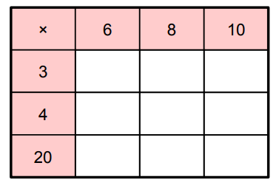
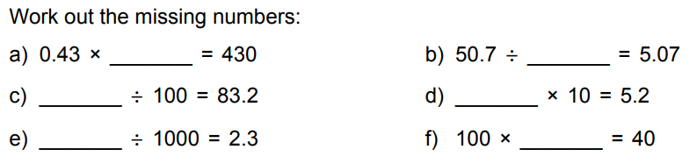
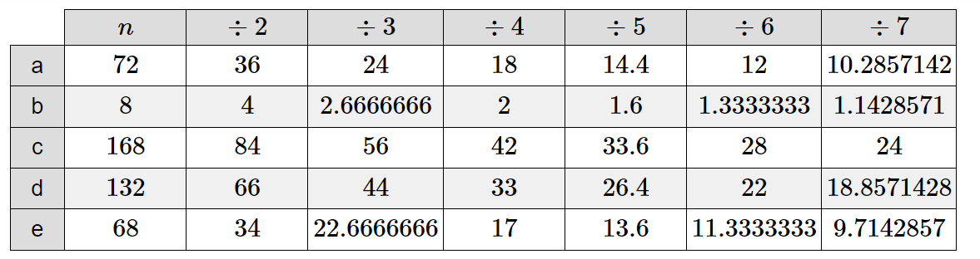
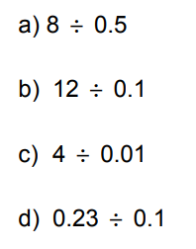
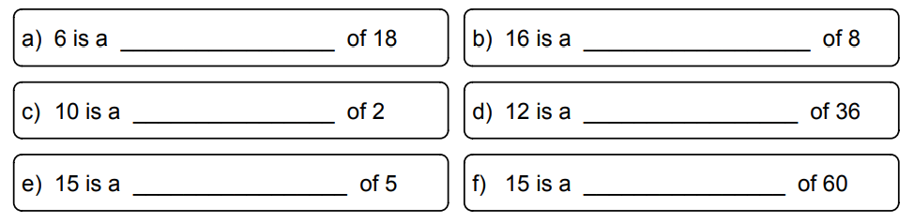
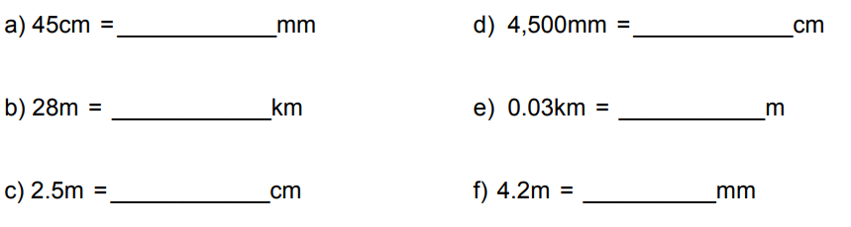
Method Selection
Mixed Fluency
1. Complete the multiplication grid: |  | 2. Work out the missing numbers:
3. Answer the following division questions:
4. Answer the following: | 5. Answer the following:
6. Fill in the blanks using the word ‘factor’ or ‘multiple’.
7. Convert the following measurements:
a)
b)
c)
d)
e)
f)
1000
8320
18 24 30
2300
24 32 40
10
120 160 200
0.52
0.4
16
11
4 x 2 + 3
5 x (3 + 4) – 9
3 + 2²
(3 + 1)² + 10 ÷ 2
120
26
400
7
2.3
21
factor
multiple
multiple
factor
multiple
factor
450
450
0.028
30
250
4200

Slide 9
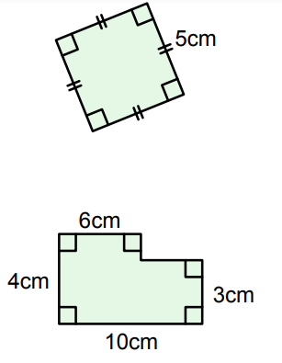
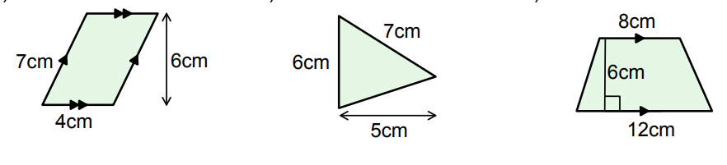
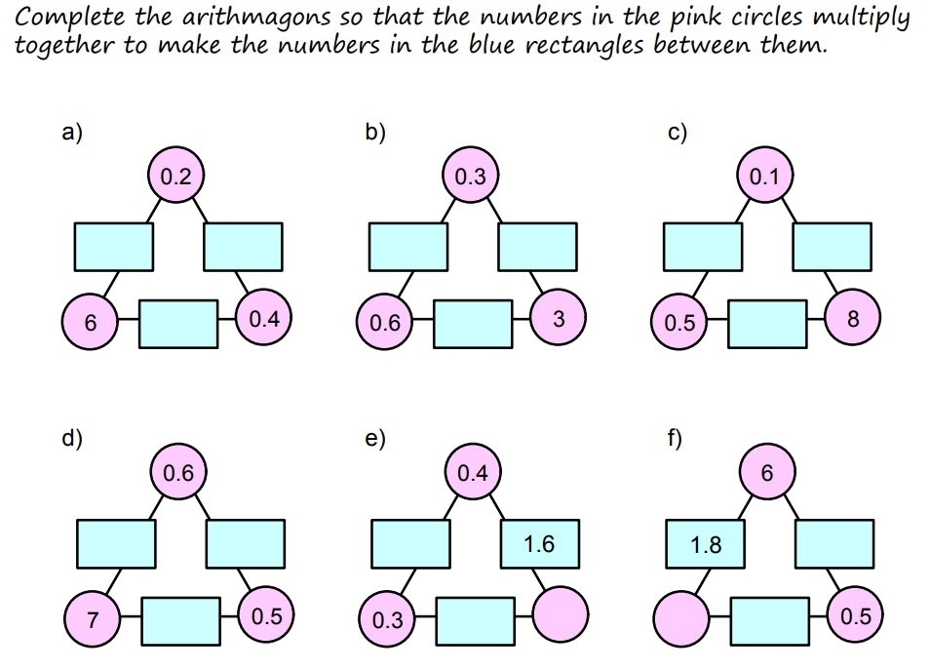
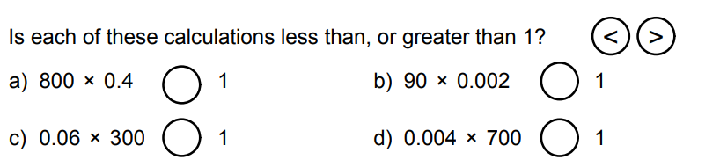
Method Selection
Mixed Fluency (continued)
8. Calculate the area of the following shapes:
9. a) Write down a multiple of 8 that is between 45 and 50. b) Find the lowest common multiple of 8 and 14. c) Write down the lowest common multiple of 8, 14 and 4.
Unfamiliar Contexts
10. Complete the arithmagons so that the numbers in the circles multiple together to make the numbers in the blue rectangles between them.
11. Find the number half way between: 17 and 35 143 and 641 82.5 and 91 1.801 and 1.84 | 12. Is each of these calculations less than, or greater than 1?
25cm²
24cm²
15cm²
36cm²
48
56
56
0.05
0.08
4.2
0.03
0.12
3
4
3.5
1.2
4
0.3
0.15
26
784
a)
b)
c)
d)
<
<
173.5
<
2.921
<

Slide 11
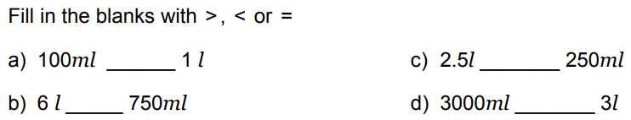
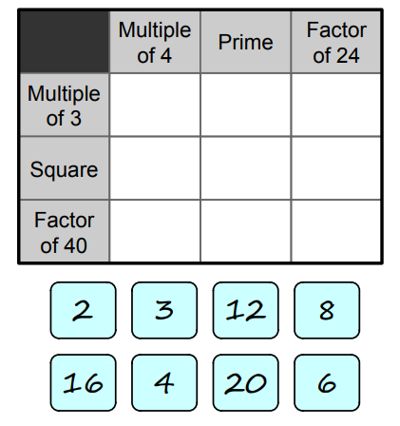
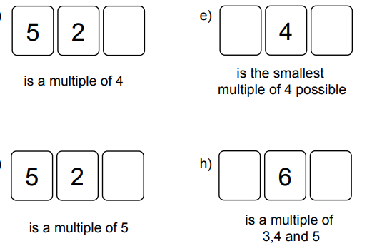
Method Selection
Unfamiliar Contexts (continued)
13.
14. Place the numbers in the correct places in the grid. In each puzzle, one square does not have any numbers in it. Put a cross in this square. | 15. Place a number in each box to satisfy the conditions stated for each 3-digit number.
16. A rectangle has a width of 3cm and a height of 2cm. Draw a second rectangle so that the two rectangles have a mean area of 13cm² and a median perimeter of 14cm.
17. Sausages are available in packs of 8. Buns are available in packs of 12. A caterer is instructed to barbecue enough hot dogs for 60 guests. Each guest consumes one hot dog (made up of one sausage and one bun). The caterer buys an equal number of sausages and buns. Assuming all 60 guests have one hot dog each, what is the smallest number of hot dogs the caterer will have left over?
<
<
<
=
1
0
12
3
6
0, 4 or 8
16
X
4
20
2
8
0
0 or 5
3, 6 or 9
5cm
4cm
12 hotdogs

Slide 13
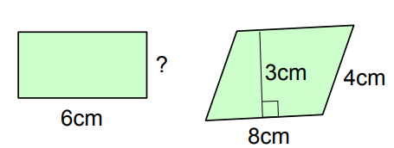
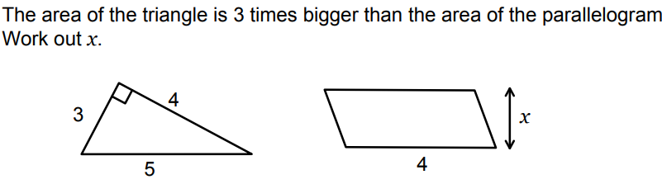
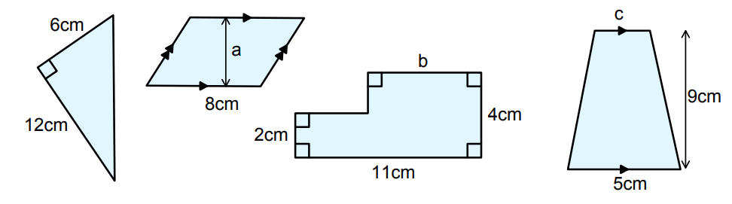
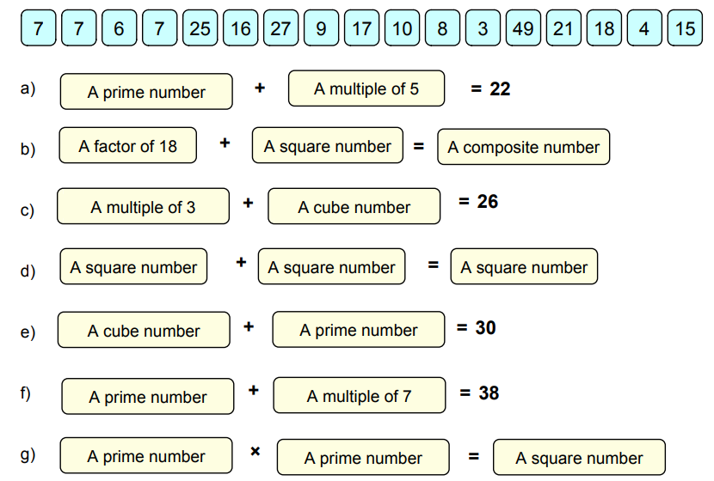
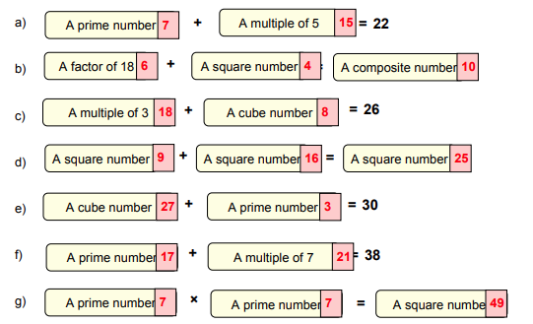
Method Selection
Unfamiliar Contexts (continued)
18. This rectangle and parallelogram have the same area. Work out the length marked ‘?’. | 19. The area of the triangle is 3 times bigger than the area of the parallelogram. Work out x.
20. These shapes all have the same area. Calculate the missing dimensions.
4cm
1.5cm
4cm
3cm
6cm
c
a =
b =
c =
4.5cm
7cm
8cm

Slide 15
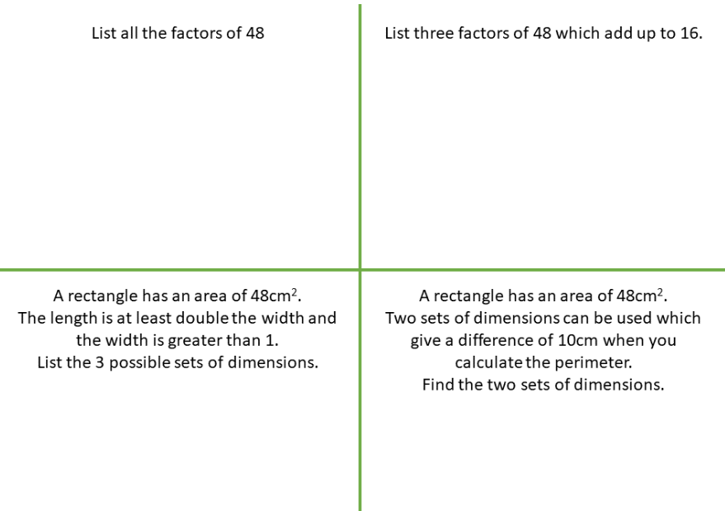
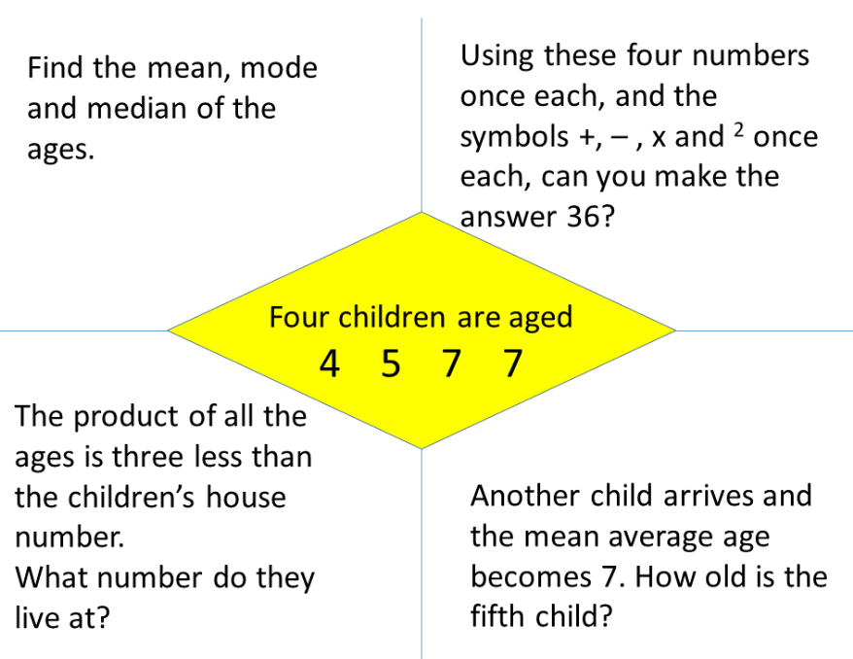
Method Selection
SSDD
SSDD
1, 2, 3, 4, 6, 8, 12, 16, 24, 48
1, 3, 12
48
2cm and 24cm
3cm and 16cm
4cm and 12cm
3cm and 16cm
6cm and 8cm
Calculate the median of the ages.
6 years old
7² + 7 – 4 x 5
983
12 years old

